Slide 1
Chapter 10
Learning Objectives:
Domain 3: Security Architecture and Engineering
3.10 Apply security principles to site and facility design
3.11 Implement site and facility security controls
3.11.1 Wiring closets/intermediate distribution facilities
3.11.2 Server rooms/data centers
3.11.3 Media storage facilities
3.11. 4 Evidence storage
3.11.5 Restricted and work area security
3.11.6 Utilities and Heating, Ventilation, and Air Conditioning (HVAC)
3.11.7 Environmental issues
3.11.8 Fire prevention, detection, and suppression

Slide 2
Chapter 10
Learning Objectives:
Domain 7: Security Operations
7.15 Implement and manage physical security
7.15.1 Perimeter security controls
7.15.2 Internal security controls

Slide 3
Apply Security Principles to Sites and Facility Design
Secure Facility Plan
Critical path analysis – systematic effort to identify relationships between mission-critical applications, processes, and operations and all the necessary supporting elements
Technology convergence –tendency for various technologies, solutions, utilities, and system to evolve and merge over time
Site Selection – should be based on security needs
Visibility – area around a facility; view of CCTV
Natural Disasters
Facility Design – floors, doors, walls ceilings, HVAC, power, sewage, etc..
Crime Prevention through Environmental Design (CPTED)

Slide 4
Implement Site and Facility Security Controls
Administrative physical controls
Facility construction and selection, site management, personnel controls, awareness training
Technical physical controls
Access controls, IDS/IPS, CCTV, HVAC power supplies, fire detection and suppression
Physical controls
Fencing, lighting, locks, mantraps, guards and dogs
Functional order:
Deterrence, Denial, Detection, Delay

Slide 5
Equipment Failure
Equipment failure can take many forms
Service-level agreement (SLA) with vendors
MTTF – mean time to failure
MTTR – mean time to recovery
MTBF – mean time between failure

Slide 6
Wiring Closets
MDF
IDF
Multiple wiring closets due to limitations of twisted-pair cabling; 100 meters
may include other elements of the building; alarm systems, circuit breaker panels, telephone punch-down blocks etc..
Cable plant management
Entrance facility – demarcation point; entrance into the building
Equipment room – main wiring closet
Backbone distribution system – cross-connection between equipment rooms; including cross-floor connections
Telecommunications room – a wiring closet
Horizontal distribution system – connections between the telecommunication room and work area

Slide 7
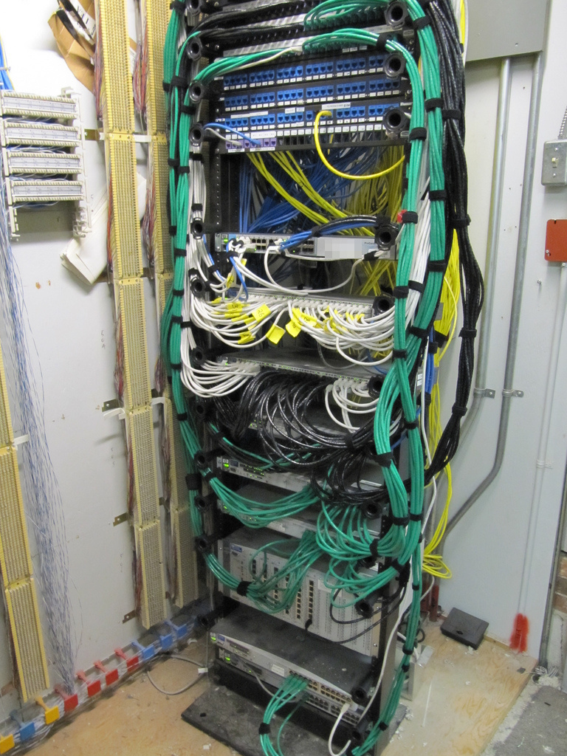
A Typical Wiring Closet

Slide 8
Server Rooms/Data Centers
Enclosed, restricted, protected rooms where mission-critical servers and network devices are housed
Human incompatibility
Located at the core of the building
Located away from water, gas, and sewage lines
Data center could be a separate building
Employ technical controls for access control mechanisms to manage physical access

Slide 9
Smartcards
Credit-card sized IDs, badges, or security passes with embedded magnetic strip, bar code, or integrated circuit chip
CAC, PIV, SIPR token, credit cards, debit cards, etc.
Susceptible to physical attack, logical attacks, Trojan horse attacks, or social engineering attacks
Memory cards are machine-readable ID cards with magnetic strip
Employs two factor authentication; something you have and something you know

Slide 10
Proximity Readers
Passive device, field-powered device, or a transponder
Passive device has no electronics
Field-powered device activates when nears an electromagnetic field generated by the reader
Transponder is a self-powered device that transmits a signal to the reader (garage door opener or car alarm key fob)
Radio Frequency Identification (RFID) or biometric access control devices

Slide 11
Intrusion Detection Systems
IDSs are systems designed to detect
an attempted intrusion, breach, or attack
The use of an unauthorized entry point
Occurrence of some specific event at an unauthorized or abnormal time
Physical intrusion – burglar alarms
Can be a logical technology
Heartbeat sensor is a mechanism by which the communication pathway is either constantly or periodically checked with a test signal

Slide 12
Access Abuses
Propping open a controlled access door
Masquerading – using someone else’s security ID to gain access
Piggybacking (Tailgating) – following someone through a security gate or doorway with being identified or authorized
Audit trails and access logs are useful tools
CCTV

Slide 13
Emanation Security
Electrical devices emanate electrical signals or radiation that can be intercepted by unauthorized individuals
TEMPEST
Faraday cage
White Noise
Control Zone

Slide 14
Media Storage Facilities
Designed to securely store blank media, reusable media, and installation media
HDDs, flash memory devices, optical disks, or tapes should be controlled against theft and corruption
Data remnants - remaining data element left on a storage device after a standard deletion or formatting process
Clears the directory structure and marks clusters as available for use, but original data remains

Slide 15
Evidence Storage
Becoming a necessity for all businesses, not just law enforcement
Important to retain logs, audit trails, and other recorded of digital events
Preserving datasets that might be used as evidence is essential to the favorable conclusion to a corporate internal investigation or law enforcement investigation of cybercrime

Slide 16
Restricted and Work Area Security
The design and configuration of internal security should be considered carefully
Areas that contain assets of higher value or importance should have more restricted access
Valuable and confidential assets should be located in the center of protection provided by a facility
Deploy concentric rings or circles of protection
Walls or partitions can be used to separate similar but distinct work areas
Each work area should be evaluated and assigned a classification just as IT assets are classified; think OSS
Facility security design process should support the implantation and operation of internal security
Example; Sensitive Compartmented Information Facility (SCIF)

Slide 17
Utilities and HVAC Considerations
Power from the electric companies is not always consistent and clean
Most electronic equipment demands clean power
UPS
Power strips with surge protectors
Generators

Slide 18
Utilities and HVAC Considerations
Terms you should know:
Fault: momentary loss of power
Blackout: compete loss of power
Sag: momentary low voltage
Brownout: prolonged low voltage
Spike: momentary high voltage
Surge: prolonged high voltage
Inrush: initial surge of power associated with connecting to a power source
Noise: steady interfering power disturbance or fluctuation
Transient: short duration of line noise disturbance
Clean nonfluctuating pure power
Ground: wire in an electrical circuit that is grounded

Slide 19
Noise
Can interfere with the quality of communications, transmissions, and playback
Two type of noise:
Electromagnetic interference (EMI)
Two modes:
Common Mode – generated by a difference in power between hot and ground wires of a power source
Transverse Mode – generated by different in power between the hot and neutral wires of a power source
Radio Frequency interference (RFI)
Fluorescent lights, electrical cables, electric space heaters, computers, elevators, motors, etc.
Steps for protection against EMI and RFI:
Power conditioning, proper grounding, shielding all cables, and limit exposure to EMI/RFI

Slide 20
Temperature, Humidity, and Static
Maintaining relative temperature and humidity
60-75 degrees Fahrenheit
40%-60% humidity
Study the following table:
Static voltage | Possible damage
40 | Destruction of sensitive circuits and other electronic components
1,000 | Scrambling of monitor displays
1,500 | Destruction of data stored data on hard drives
2,000 | Abrupt system shutdown
4,000 | Printer jam or component damage
17,000 | Permanent circuit damage

Slide 21
Water Issues (e.g., Leakage, Flooding)
Water and electricity don’t mix
Electrocution
Leakage and flooding should be addressed in your environmental safety policy
Locate servers and data equipment away from water sources
Water-detections systems sound an alarm and alert if water is encroaching on the equipment
Know where the water shut-off valve and drainage locations

Slide 22
Fire Prevention, Detection, and Suppression
Fire prevention, detection, and suppression must not be overlooked
Protecting personnel is the most important goal of any security or protection system
The requirements for fire: fuel, heat, and oxygen
Different suppression mediums address different aspects of the fire:
Water suppresses the temperature
Soda acid and dry powders suppresses the fuel supply
CO2 suppresses the oxygen
Halon substitutes and other nonflammable gases interfere with the chemistry of combustion and/or suppress the oxygen supply

Slide 23
The Fire Triangle
Heat
Chemical
Reaction
Oxygen
Fuel

Slide 24
Fire Prevention, Detection, and Suppression
Stage of fire:
Stage 1: The Incipient Stage - The is only air ionization but no smoke
Stage 2: The Smoke Stage - Smoke is visible from the point of ignition
Stage 3: The Flame Stage - A flame can be seen with the naked eye
Stage 4: The Heat Stage - The fire is considerably further down the timescale to the point where there is intense heat buildup
Proper personnel awareness training of important

Slide 25
Four Primary Stages of Fire
Stage 4: Heat
Temperature
Stage 2: Smoke
Stage 3: Flame
Time
Stage 1: Incipient

Slide 26
Fire Extinguishers
Improper use of a fire extinguisher can actually spread a fire
Fire extinguisher classes:
Class | Type | Suppression material
A | Common combustibles | Water, soda acid
B | Liquids | CO2, Halon*, soda acid
C | Electrical | CO2, Halon*
D | Metal | Dry powder

Slide 27
Fire Detection Systems
Protecting facilities requires installation of automated fire detection and suppression systems
Types of fire detection system:
Fixed-temperature detection – triggers when a specific temperature is reached
Rate-of-rise detection – trigger when the speed at which the temperature changes reaches a specific level
Flame-actuated – triggers based on infrared energy of flames
Smoke-actuated – uses photoelectric or radioactive ionization sensors as triggers
Incipient smoke detection systems (aspirating sensors) detect the chemicals associated with the very early stages of combustion before a fire is otherwise detectable
Most fire-detection system can be linked to fire response service notification mechanisms

Slide 28
Water Suppression Systems
Wet pipe system (closed head system)
Always full of water
Dry pipe system
Contains compressed air; once triggered, air escapes, opens the water valve
Deluge system
Another form of dry pipe that uses larger pipes and therefore delivers significantly larger volume of water
Preaction system
Combination dry pipe/wet pipe system; exits as a dry pipe until the initial stages of a fire are detected, and then the pipes are filled with water. The water is released only after the sprinkler head activation triggers are melted by sufficient heat. Can be manually reset if fire is extinguished before the water is released

Slide 29
Gas Discharge Systems
Gas discharge systems are usually more effective than water systems
However, should not be used in environments in which people are located
Halon is effective but degrades into toxic gasses at 900 degrees Fahrenheit. Also a known carcinogenic
Replacements for Halon:
FM-200
CEA-410
NAF-S-III OR CEA-308
FE-13 (HCFC-23)
Argon (IG55) or Argonite (IG01)
Inergen (IG541)
Aero-K (microscopic potassium compound in aerosol form)

Slide 30
Damage
Smoke can damage most storage devices
Heat can damage any electronic or computer equipment
100 degrees – damage to storage tapes
175 degrees – damage computer hardware (CPU and RAM)
350 degrees – damage paper products through warping and discoloration
Suppression media can cause short circuits, initiate corrosion, or render equipment useless

Slide 31
Implement and Manage Physical Security
Perimeter Security Controls
Fences (note fence heights on page 423)
Gates
Turnstiles – prevents more than one person at a time from gaining and only in one direction
Mantraps – Interlocking doors
Security bollards
Lighting – most commonly used form of perimeter security control
Security Guards and Dogs – active security control, but not a perfect solution

Slide 32
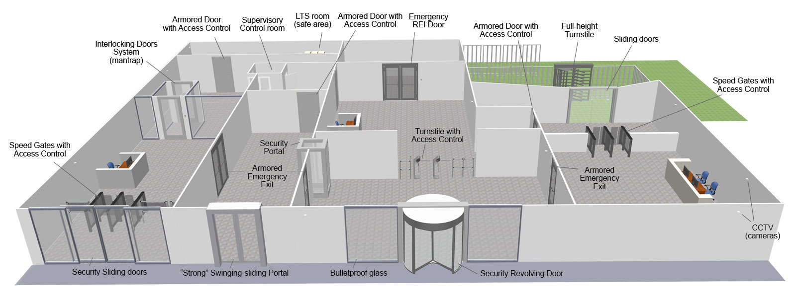
Secure Physical Boundaries with Mantraps and Turnstiles

Slide 33
Internal Security Controls
Keys and Combination Locks
Key locks (preset locks) are the most common and inexpensive form of physical access control devices
Locks serve as an alternative to security guards as a perimeter entrance access control device
Badges
Simple as a name tab or complex as a smart card

Slide 34
Internal Security Controls
Motion Detectors or motion sensor
Types:
Infrared motion detector monitors for significant changes in the infrared lighting pattern of monitored area
Heat-based motion detector monitors for significant changes in the heat levels and patterns in a monitored area
Wave pattern motion detector transmits a constant low ultrasonic or high microwave frequency signal into a monitored area and monitors for significant changes or disturbances in reflected patterns
Capacitance motion detector sense changes in electrical or magnetic field surrounding a monitored object
Photoelectric motion detector senses changes in visible light levels for the monitored area; usually deployed in internal rooms that have no windows and are kept dark
Passive audio motion detector listens for abnormal sounds in the monitored area

Slide 35
Internal Security Controls
Intrusion Alarms
Deterrent alarms trigger deterrents; locks, shut doors, etc.
Repellent alarms trigger repellants; siren or bell and/or turn on lights
Notification alarms trigger notification that are often silent from the intruder/attacker perspective but record data about the incident and notify administrators, security guards, and law enforcement
Local alarm systems must broadcast an audible alarm signal that can be easily hear up to 400 feet away; protect from tampering and disablement
Central Station system usually silent locally, but offsite monitoring agents are notified so they can respond to the security breach
Auxiliary station systems can be added to either local or centralized alarm systems

Slide 36
Internal Security Controls
Secondary Verification Mechanisms
Deploy security systems in pairs to reduce false negatives
Environmental and Life Safety
Protect human life
Privacy Responsibilities and Legal Requirements
Privacy means protecting personal information from disclosure to unauthorized individuals
Regulatory Requirements
Every organization operates within a certain industry and jurisdiction
Legal requirements can apply to licensed use of software, hiring restrictions, handling of sensitive materials, and compliance with safety regulations

Slide 37
Summary
Control over the physical environment
Facility design
Security controls to mange physical security
Types of physical access control mechanisms
Wiring closets and server rooms
Media storage security
Fire detection and suppression
Protect human life!

